Slide 2

Fixed Asset project
Team/ G3- Group 1
Instructor/ Eng. Ahmed El-zahed

Slide 3
Scope Of Project
Accounts …………………………………….4_8
Category values …………………………9_16
Location values ……………………………17_20
Asset key values …………………………..21_22
Fiscal year …………………………………..23
Calendar year ……………………………..24
Prorate convenient ………………………25
Location combination ………………….26_28
Asset key combination …………………29
Book …………………………………………30
Categories …………………………………31_40
Addition …………………………………….41_47
Quick addition ……………………………48_50
Assets from payables ……………….51_73
Production ………………………………74_78
Run depreciation………………………79_81

Slide 4
Create account …………………………………….82_84
Transfer Journal Entries to GL …………………85_88
Retirement ………………………………………….89_93
Assignment ………………………………………..94_97
Amortization ………………………………………98_101
adjustment ………………………………………..102_115
Transfers …………………………………………..116_130
Changes …………………………………………..131_141
Reclassifications ……………………………………. 142_146
Revaluations ………………………………147_153
Assets from journal ……………………………154_170
Greate journal …………………………………….171_172
Auto copy batch ………………………………….173_174
Reverse ……………………………………………..175_181
Enter Currency …………………………………….182_185
Recurring journal ……………………………….186_192
Closing period …………………………………….193_194

Slide 5
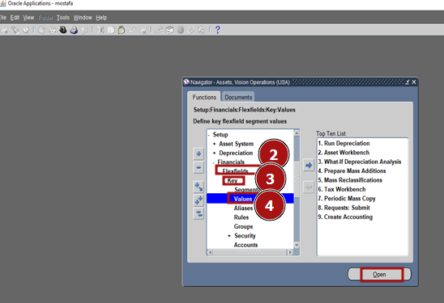
click on setup – financial – flexfields– key - values

Slide 6
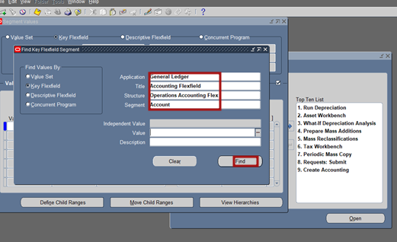
1.creating account Fill in application (general ledger), title ( accounting flix field), segment ( account), then press find

Slide 7
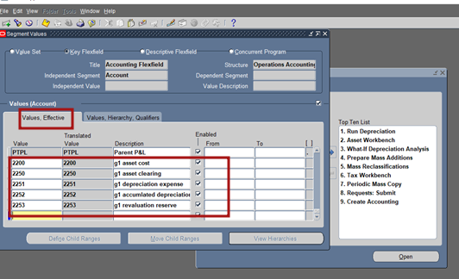
- In order to create aacounts we have to Enter values and accounts as shown, then press value, hierarchy & qualifiers

Slide 8
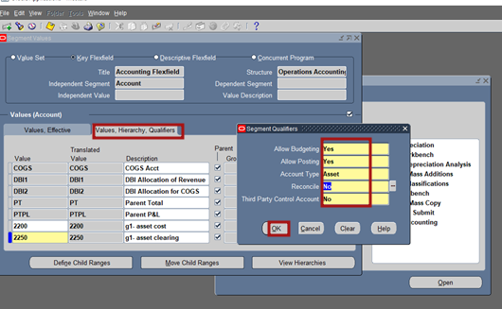
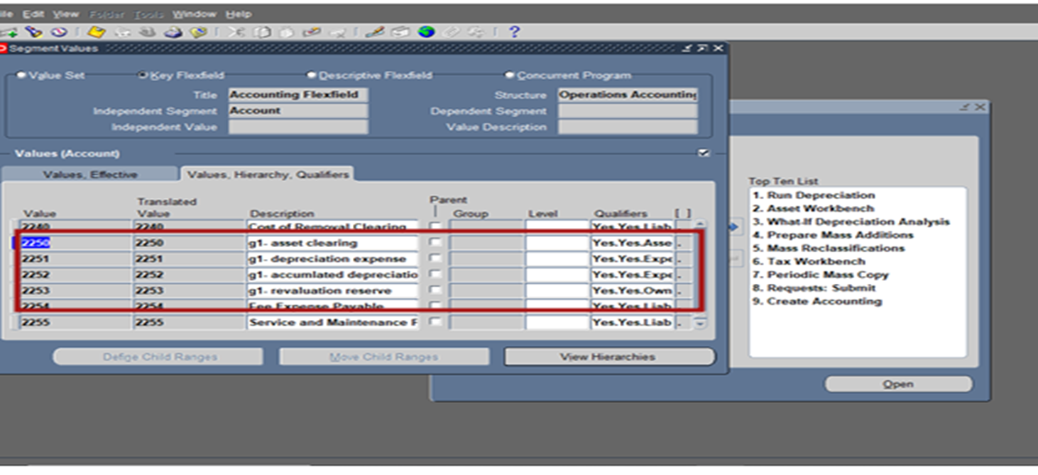
- The final step for creating aacounts

Slide 9
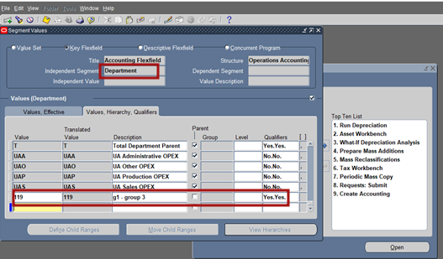
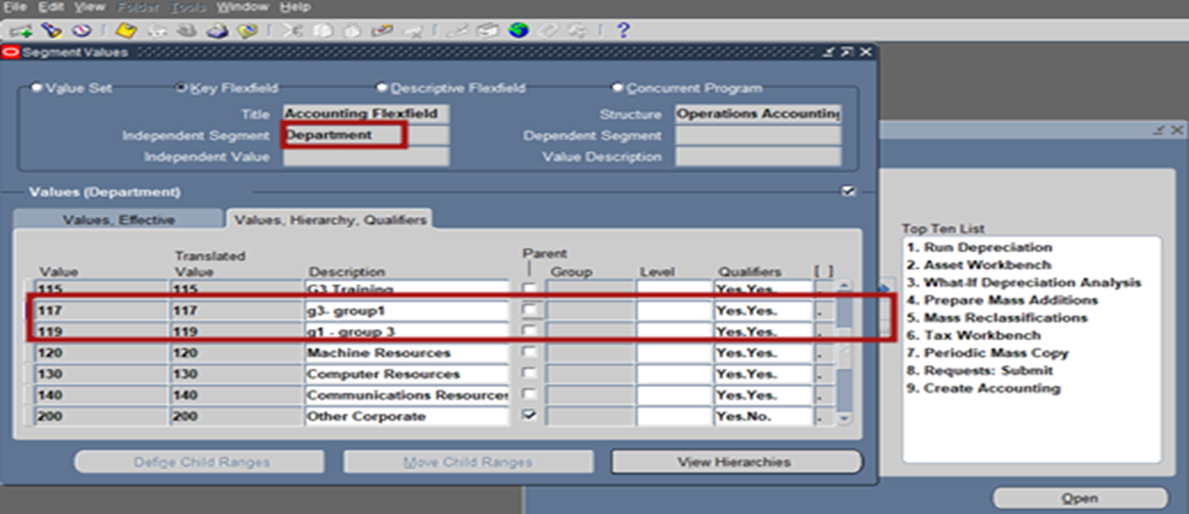
creating department enter in segment (department) and press find enter values and description ( g1- group3)

Slide 10
2. Category values
We will create categories for STL method and a category for number of production method
First: In order to create categories of assets follow this steps on tha app

Slide 11
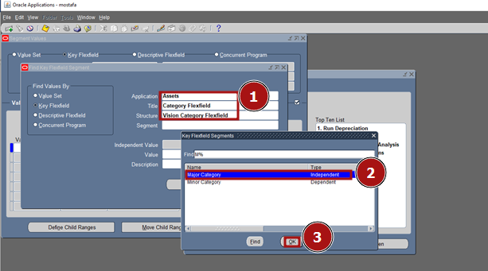
- we have to create the major category Fill in application (assets), title (category flix field), segment (major category)

Slide 12
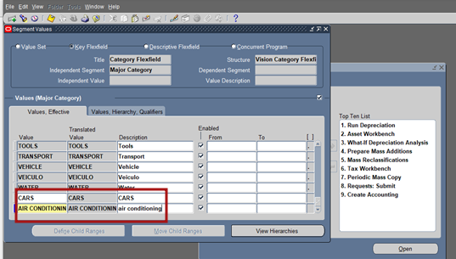
Now: we will enter the major category

Slide 13
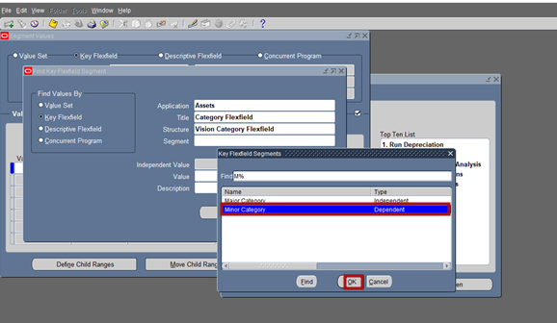
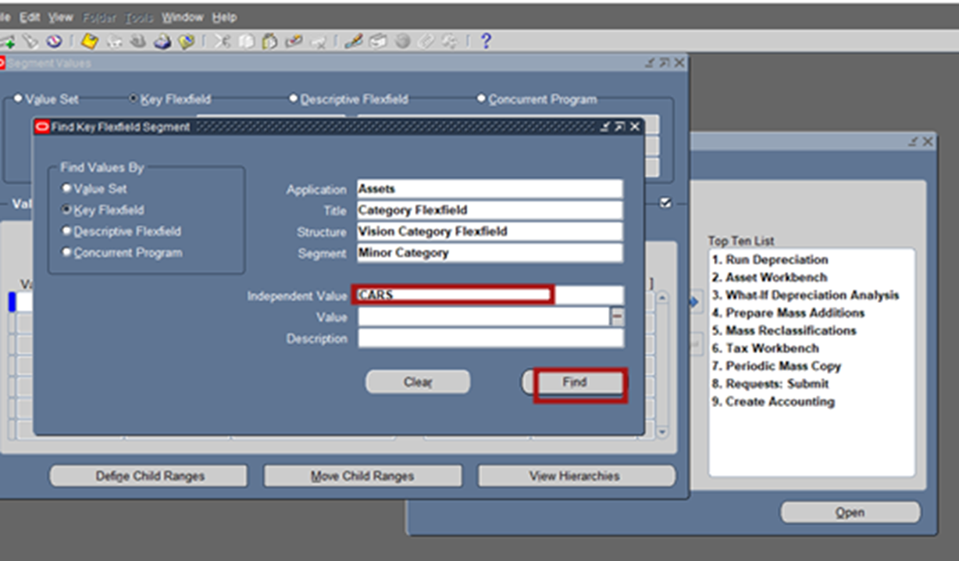
to Create minor category we have to choose one of our major category in the independent value as shown

Slide 14
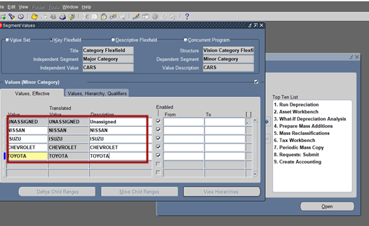
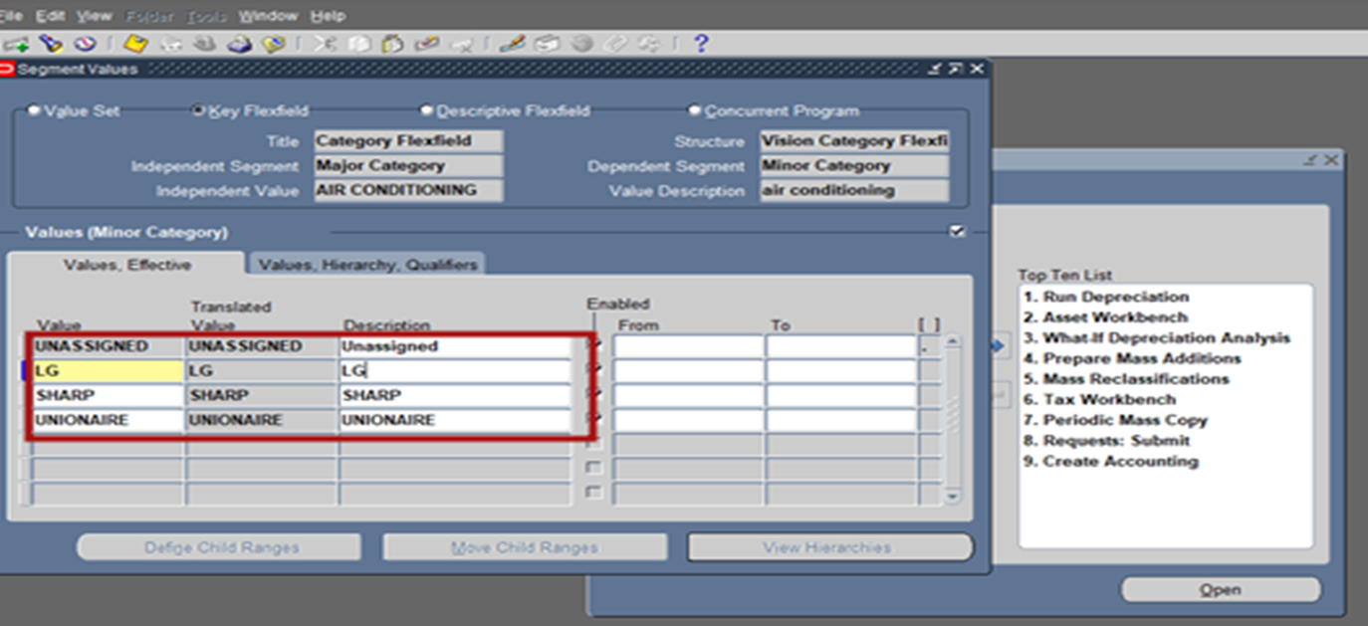
Minor Category for Cars (Nissan , Isuzu , Chevrolet, Toyota)
Minor Category for Air Conditioning (lg, sharp, unionaire)

Slide 15
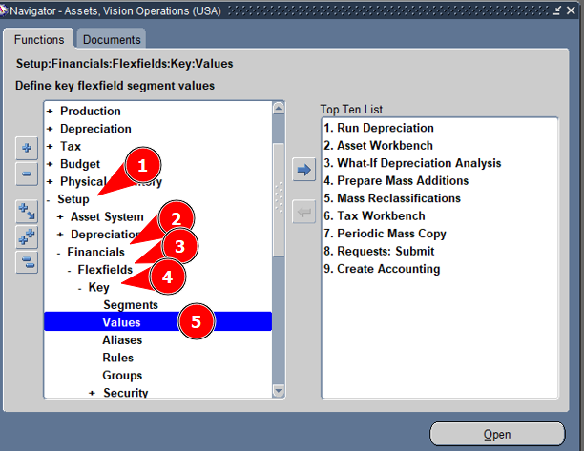
second: Creating Category for Number of Production Method

Slide 16
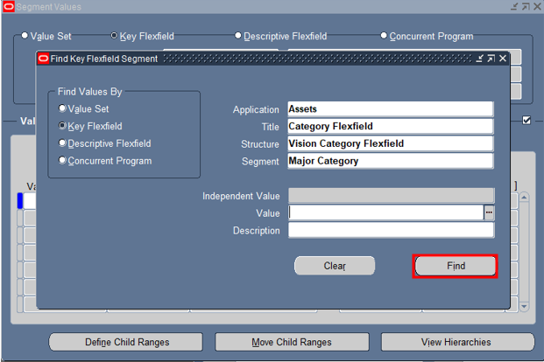
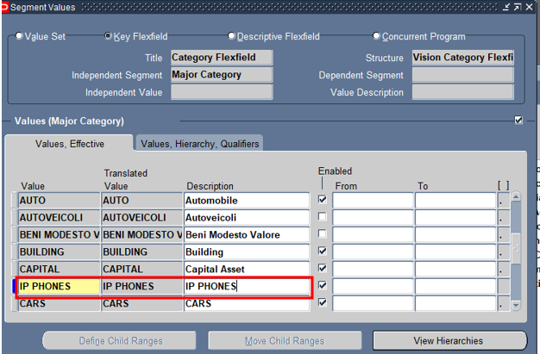

1. Create IP phones as major category
Press the add icon in the tool bar of the program

Slide 17
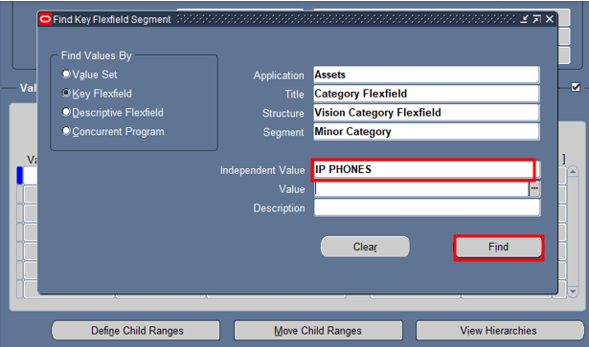
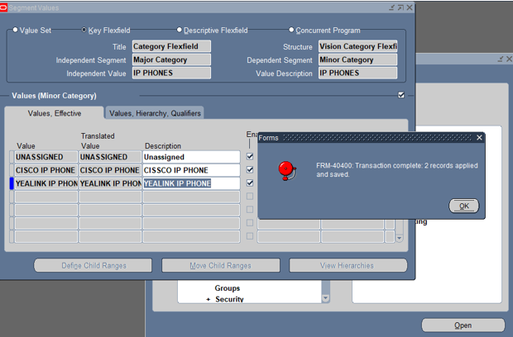
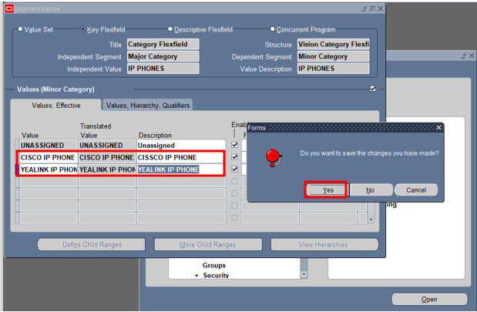
2. Create items as minor category

Slide 18
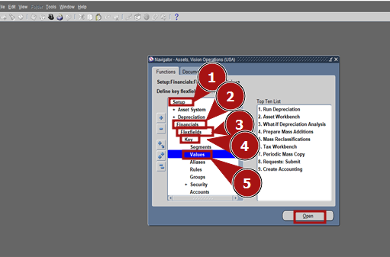
3. Location values for creating location click setup – financial – flix field – key - values

Slide 19
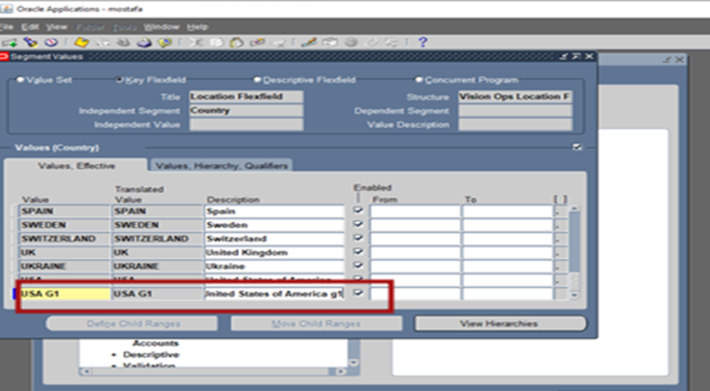
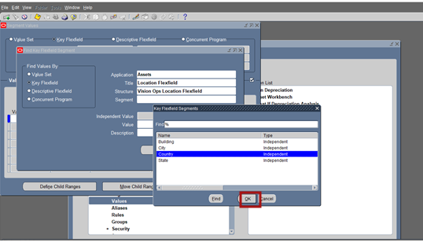

Slide 20
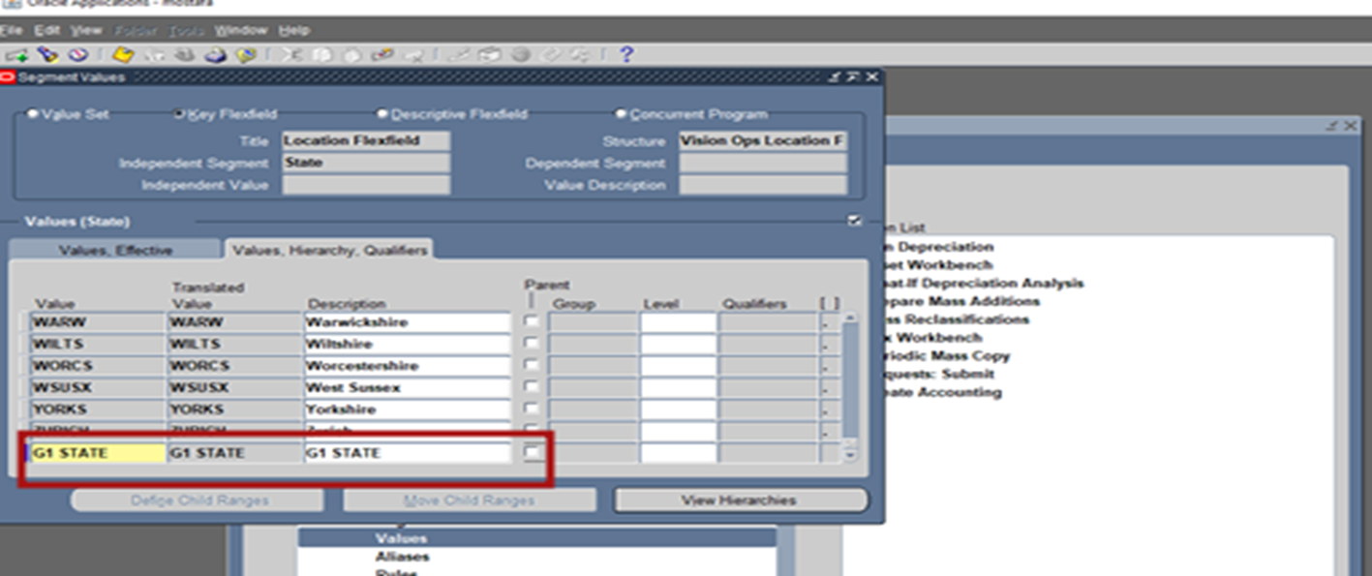
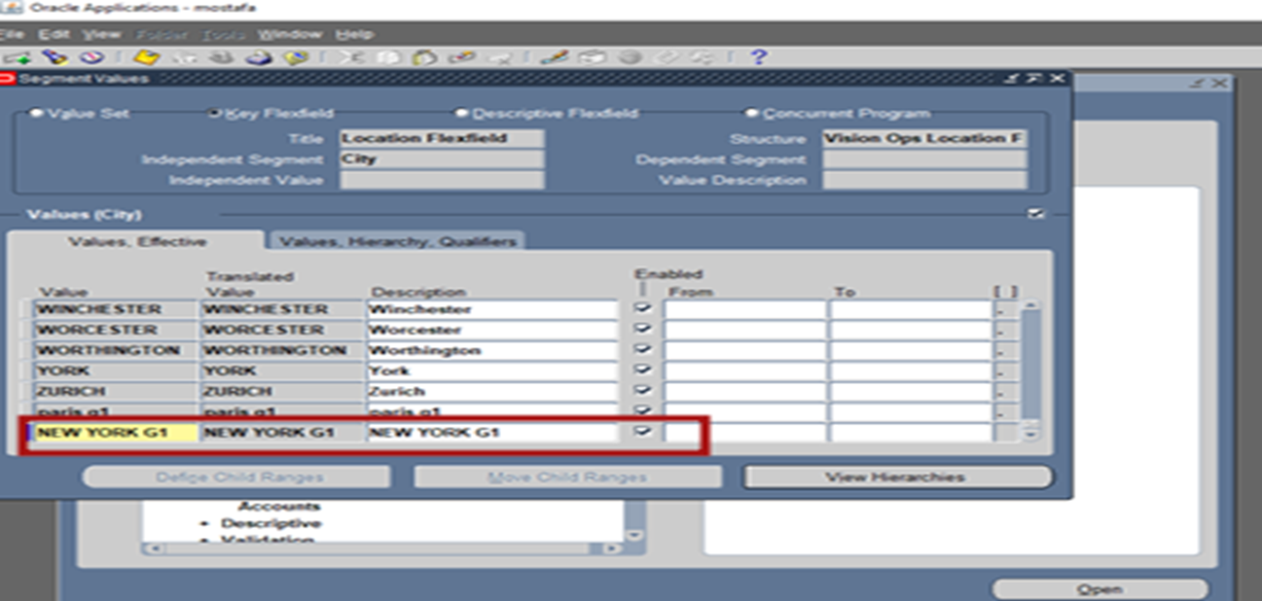
Enter country as USA G1, Enter state as G1 state

Slide 21
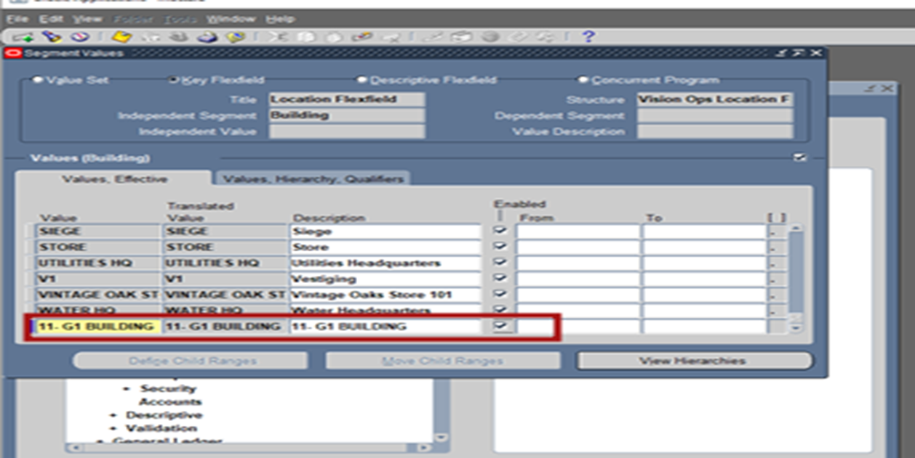
Enter building as 11- G1 Building

Slide 22
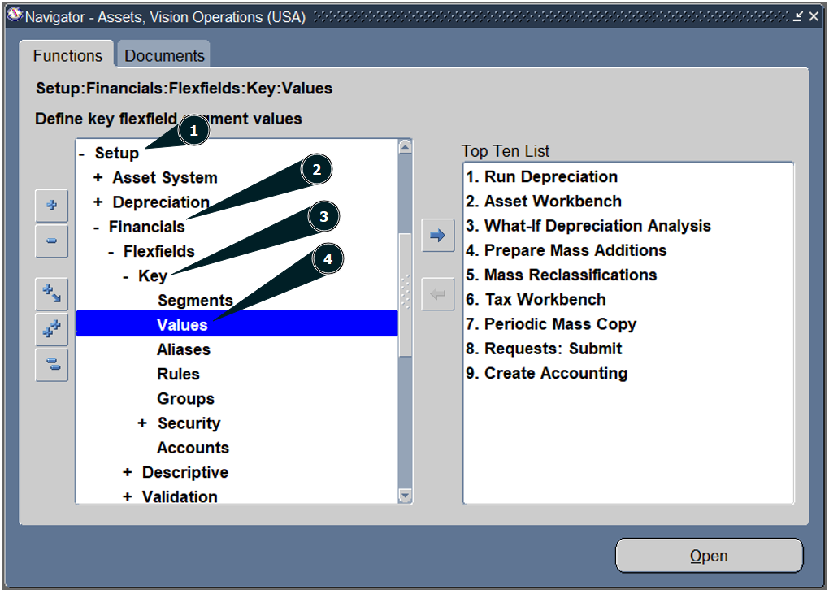
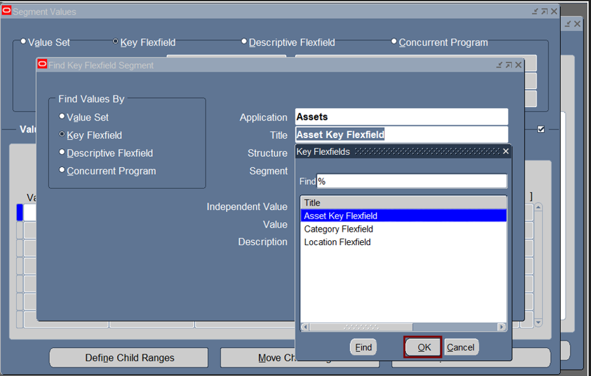
4. Asset key values
Create key to describing asset.

Slide 23
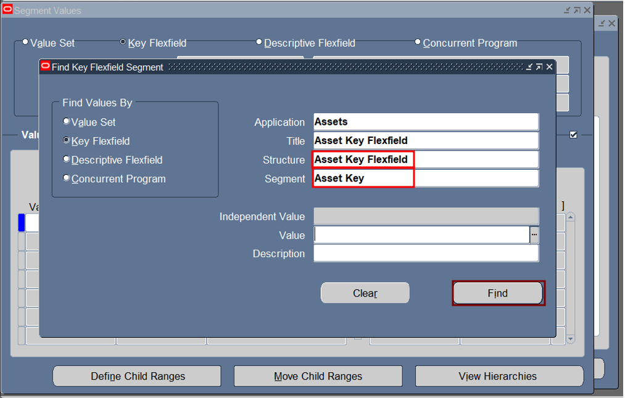
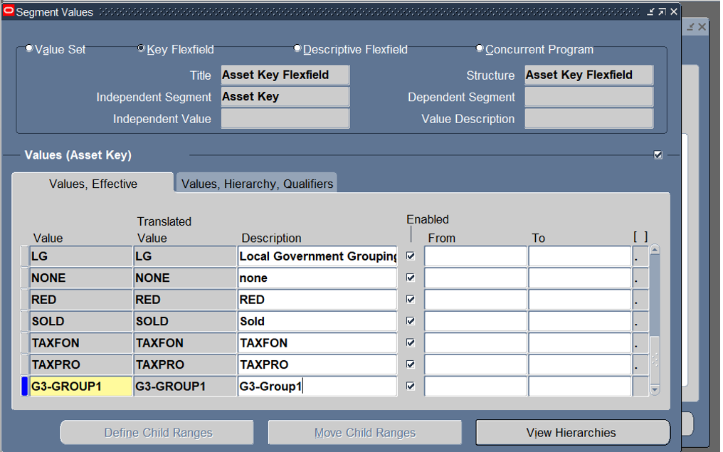
Structure and segment fill automatically

Slide 24
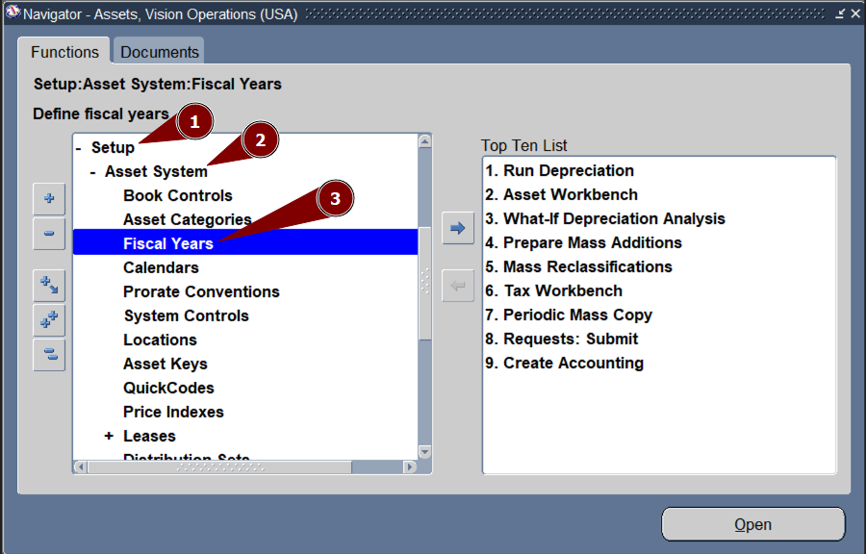
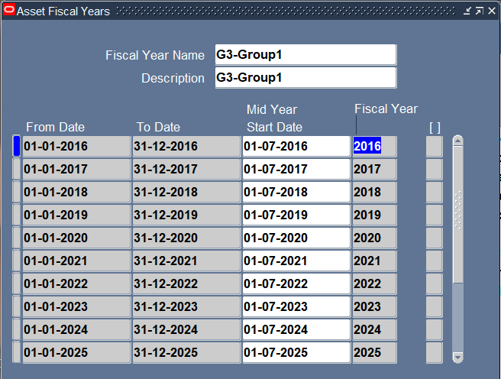
5. Fiscal year
Fiscal years is used to determine the asset’s years

Slide 25
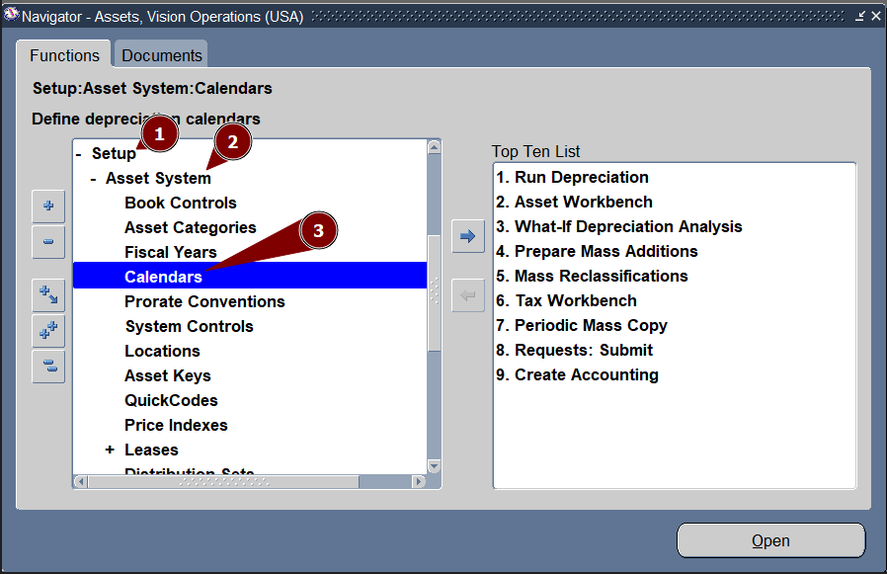
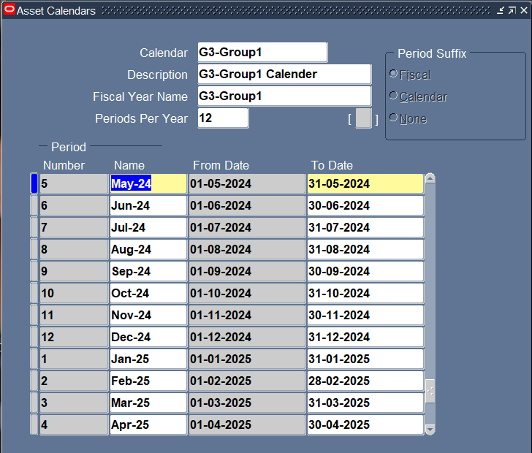
24
6. Calender key
Calendar is used to determine the asset’s month

Slide 26
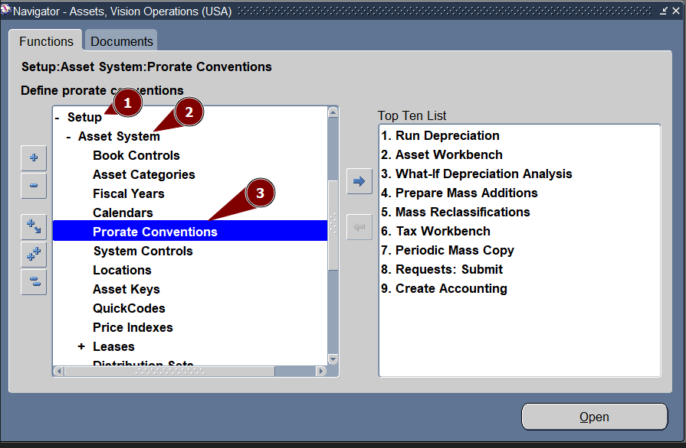
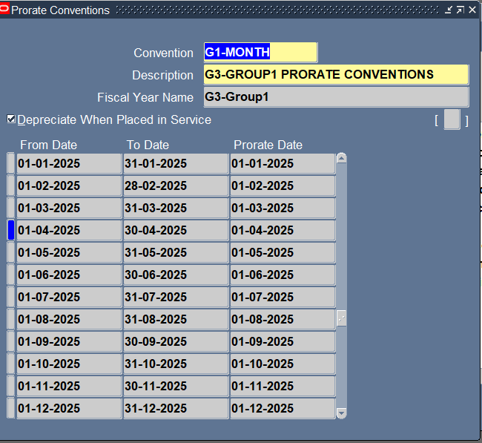
7. Prorate convention Prorate conventions is used to determine the month’s depreciation

Slide 27
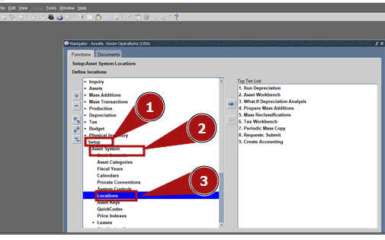
8. Location compination Click setup – asset system - location

Slide 28
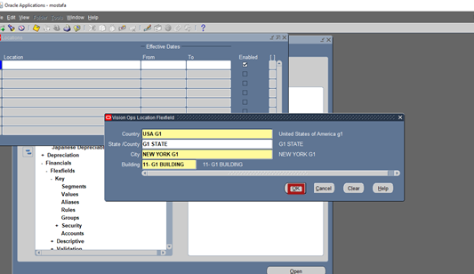
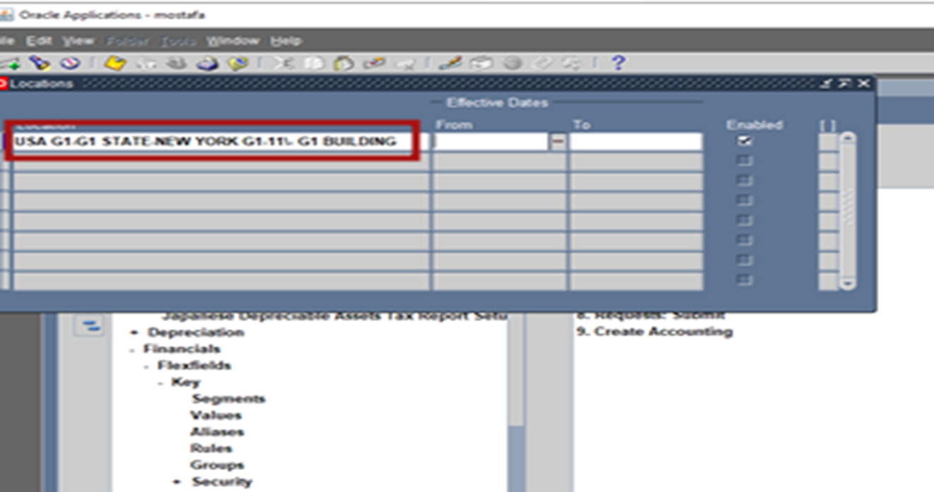
Follow the steps to create location compination

